Slide 1


2018 IEEE International Conference on Computer Communications (INFOCOM 2018)
CAPS: Coding-based Adaptive Packet Spraying to Reduce Flow Completion Time in Data Center
Jinbin Hu¹ , Jiawei Huang¹, Wenjun Lv¹, Yutao Zhou¹, Jianxin Wang¹, Tian He²
¹Central South University, China
²University of Minnesota, USA

Slide 2
Outline
Background
Motivation
Impacts of Long Flows on Short Flows
CAPS Design
Evaluation
Summary

Slide 3

Background
Modern datacenters are the main infrastructures to support many cloud applications, among which the data center network (DCN) plays an important role in computing and communication.
DCN 's characteristic
Low RTT
High bandwidth
Small switch buffer
Multiple equal cost paths
18/4/19
3

Slide 4
Outline
Background
Motivation
Impacts of Long Flows on Short Flows
CAPS Design
Evaluation
Summary

Slide 5
Motivation
Online services care about the flow completion time (FCT)
Large number of short flows generated in delay-sensitive applications
Coexisting with the majority of throughput-sensitive long flows
But Random Packet Spraying (RPS) ignores the mixed traffic characteristic
Long flows hurt short flows seriously
18/4/19
3
Notes:
Online services such as web search and retail care about the flow completion time.
Lots of online service providers like Google and Amazon want to obtain better user experience and financial revenue, so how to achieve the low latency and high throughput becomes a crucially important issue.
In data center, large number of short flows generated in delay-sensitive applications. Usually the size of short flows is less than 100KB. They provide only about 10% of data with around 90% of TCP flows. These short flows are coexisting with the majority of throughput-sensitive long flows. Long flows provide about 90% of data with only around 10% of TCP flows.
That means datacenter traffic is heavytailed distribution.
But Random Packet Spraying proposed in recent years ignores the mixed traffic characteristic in data center.
So Long flows hurt ,short flows seriously.

Slide 6
Outline
Background
Motivation
Impacts of Long Flows on Short Flows
Head-of-line Blocking
Out-of-order
CAPS Design
Evaluation
Summary

Slide 7
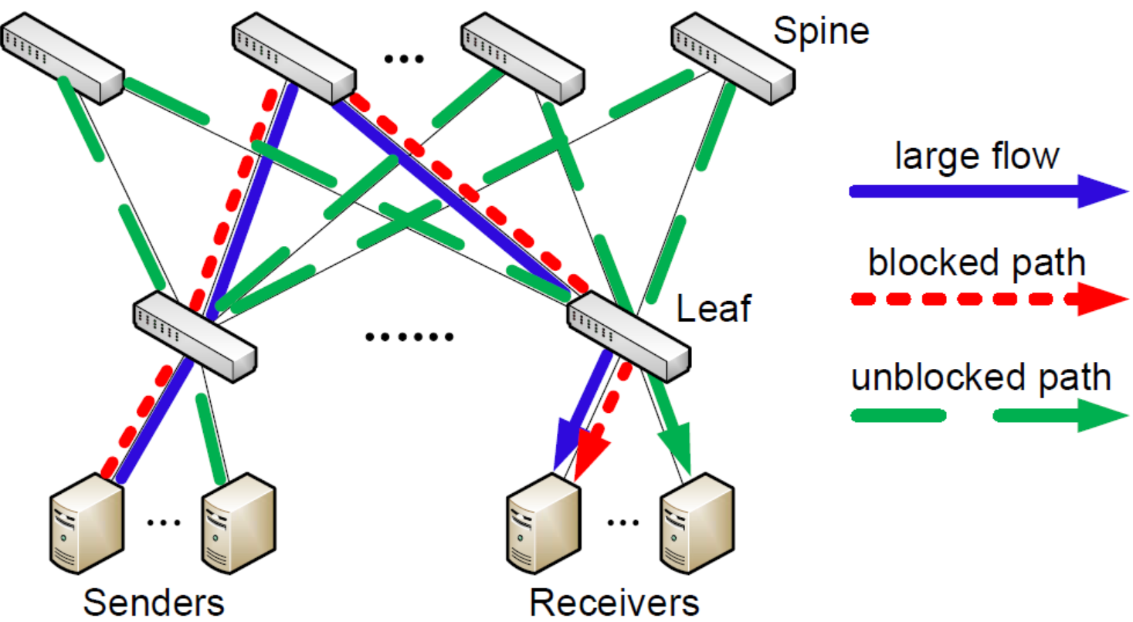
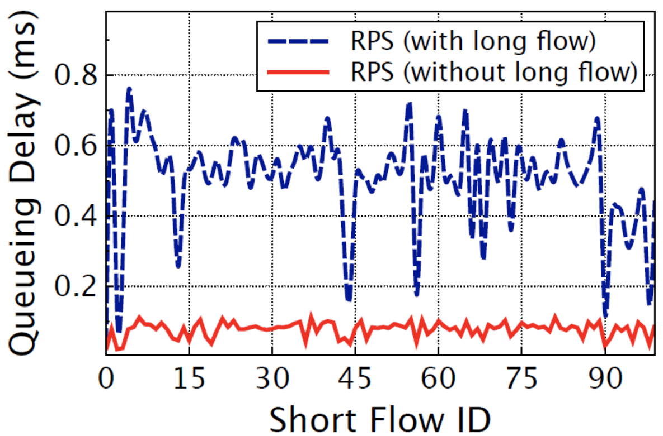
Head-of-line Blocking
Short flows queued behind the long flows
Blocked & Unblocked path
Queueing delay
Notes:
The head-of-line blocking means short flows queued behind the long flows.
leaf-spine topology. The red path is blocked path occupied by long flows. The green paths are unblocked path without long flows.
Since RPS spreads all packets to all path, some packets of short flows may be spread to the blocked paths and have to be queued behind the long flows. Therefore, they suffer from the heavy head-of-line blocking and long tailed FCT.
The figure on the right clearly shows the average queueing delay of the short flows in RPS. As you can see, the red line is the case without the long flows, so the short flows don’t experience the head-of-line blocking, and thus the average queueing delay of the short flows is reduced significantly by up to around 80%.

Slide 8
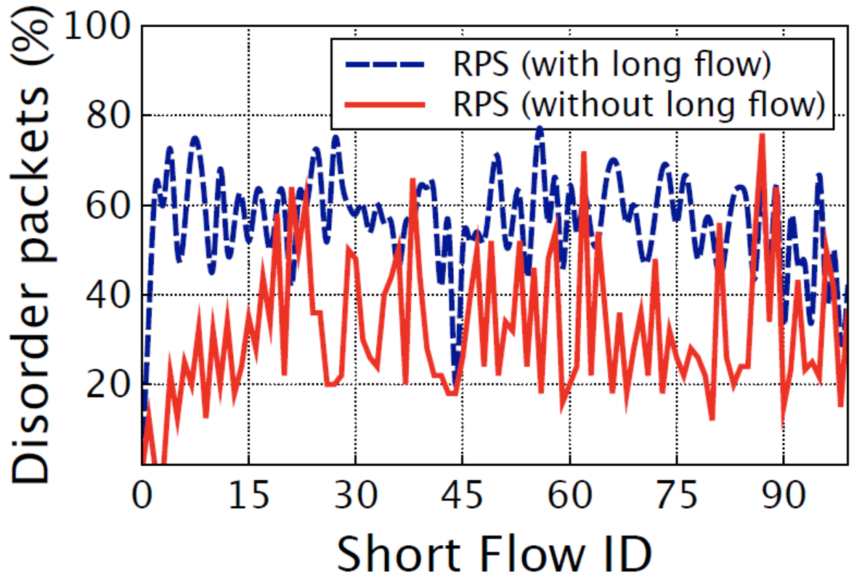
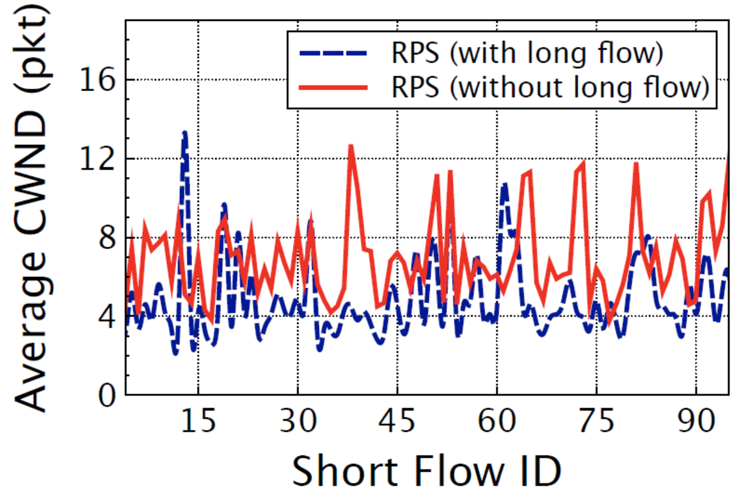
Out-of-order
Later-sent packets are received ahead of earlier-sent ones
The ratio of disorder packets
Cutting congestion window
(a) The percent of disorder packets
(b) The average congestion window
Notes:
later-sent packets may be received ahead of the earlier-sent ones.
Figure a, the blue line shows the ratio of disorder packets became larger compared with the scenario without long flows, because both kinds of flows are mixed.
When the out-of-order event happens, the TCP sender assumes the packets are lost and then cuts its congestion window, resulting in spurious retransmission and even timeout.
figure (b), the average congestion windows of the short flows are about 50% smaller than that in the scenario without long flows.
In short, as long as there is no long flows, both the queueing delay and the number of disorder packets are significantly reduced.
These motivated us to tackle the above two problems in designing CAPS.

Slide 9
Outline
Background
Motivation
Impacts of Long Flows on Short Flows
CAPS Design
Evaluation
Summary

Slide 10
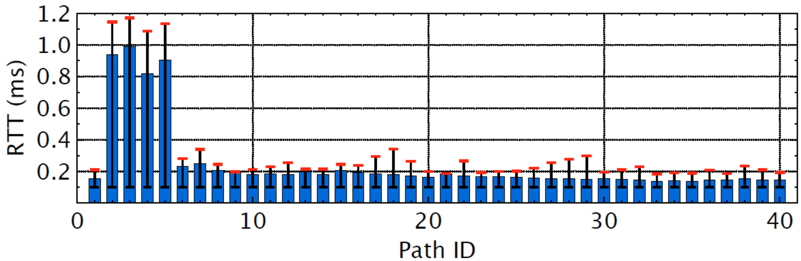
CAPS : Coding-based Adaptive Packet Spraying
Limit long flows to only a few paths by ECMP
Spread packets of short flows to all paths by RPS
18/4/19
8
Notes:
To solve the head-of-line blocking, CAPS limits long flows to only few paths by ECMP.
And simply spread packets of short flows to all paths by RPS and make full use of the multiple paths.
So most packets of the short flows are unblocked and therefore achieve the lower queueing delay.
figure, there are 40 equal cost paths.
4 blocked paths with long flows have much large RTT.
And the other 36 unblocked paths have small RTT with only short flows.
So the blocking probability by long flows can be estimated as 0.1.

Slide 11
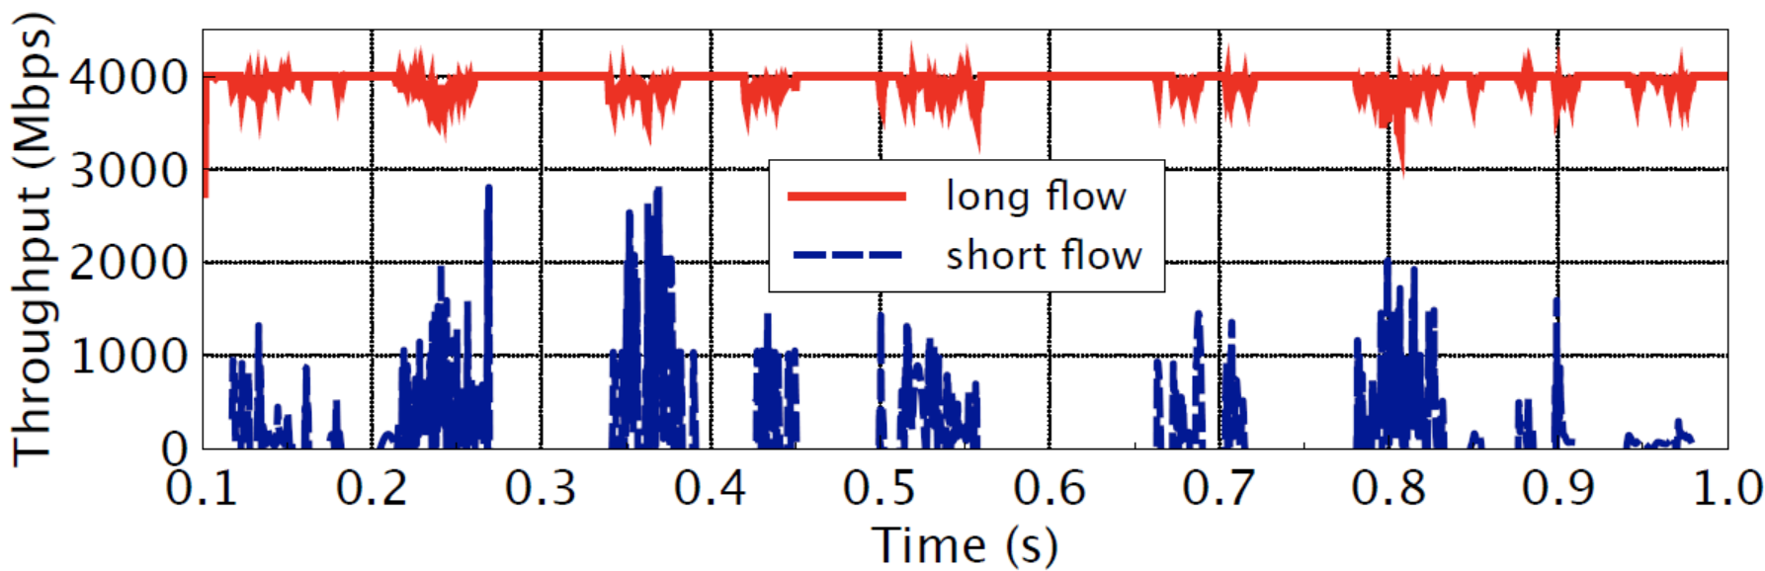
CAPS : Coding-based Adaptive Packet Spraying
FEC coding for short flows
Spread packets of long flows to all paths by RPS when short flows are in OFF mode
18/4/19
9
Notes:
To solve the out-of-order problem, we use FEC coding technology to encode the short flows. So even if some encoded packets are blocked by the long flows, the source packets can be recovered from the other non-blocked encoded packets.
To improve the throughput of long flows, we adopt different strategies to control the long flows according to the traffic pattern of short flows.
figure, the ON/OFF mode for short flows. The blue line clearly shows the throughput of short flows.
Fortunately, when the short flows are in OFF mode, we can spread the long flows to all paths with RPS to achieve high throughput.

Slide 12
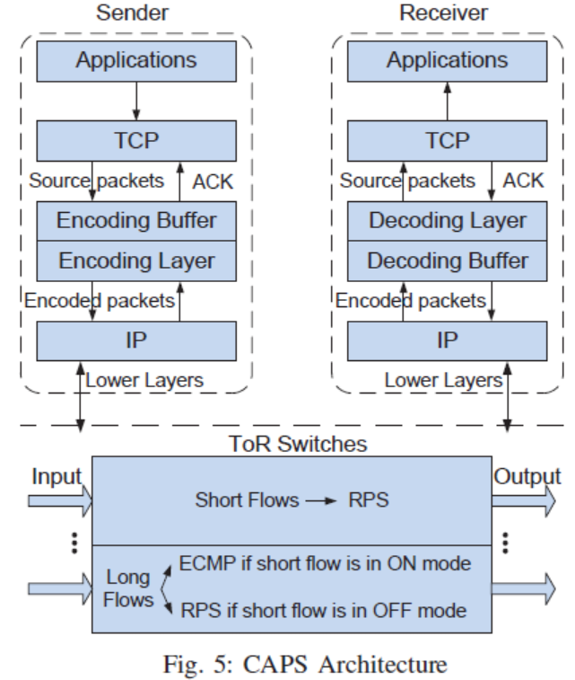
CAPS: Architecture
Sender
Receiver
Encoding module
Decoding module
Packet spraying
module
18/4/19
Notes:
the overview of CAPS. There are three key modules.
The first one is Encoding Module. On the sender side, the source packets from the transport layer cache into an encoding buffer. Then the source packets are encoded and delivered to the network layer.
The second one is Packet spraying module. At the switch, the packets of the short flows are spread to all output ports by RPS. The long flows are transmitted by ECMP or RPS respectively according to the mode of short flows.
The last one is Decoding module. On the receiver side, the encoded packets from the network layer are cached into the decoding buffer. The source packets are decoded. And then hand them up to the TCP layer.
The encoding and decoding modules only needs to be deployed between the TCP and IP layers at the end hosts, so we make no modifications on the existing TCP/IP protocols.

Slide 13
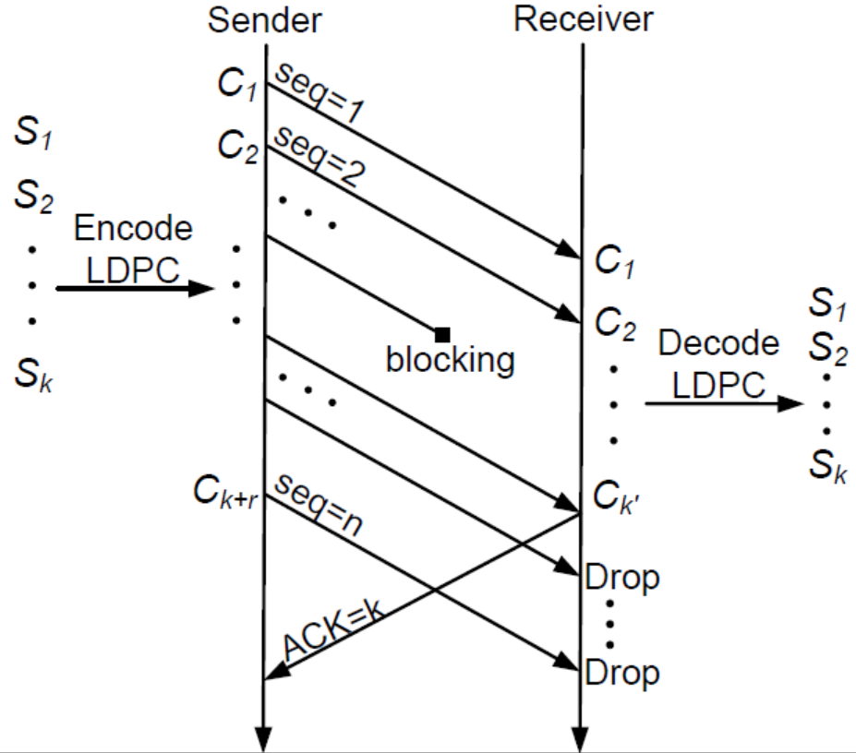
CAPS : coding
K source
packets
K+r encoded
packets
K source packets
are decoded by
K’encoded packets
18/4/19
11
Notes:
the data transmission for a coding unit.
A code unit containing k source packets is encoded into k +r encoded packets at the sender.
The receiver performs decoding process to recover the source packets from any set of k’ encoded packets.

Slide 14

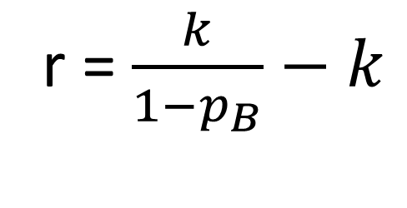
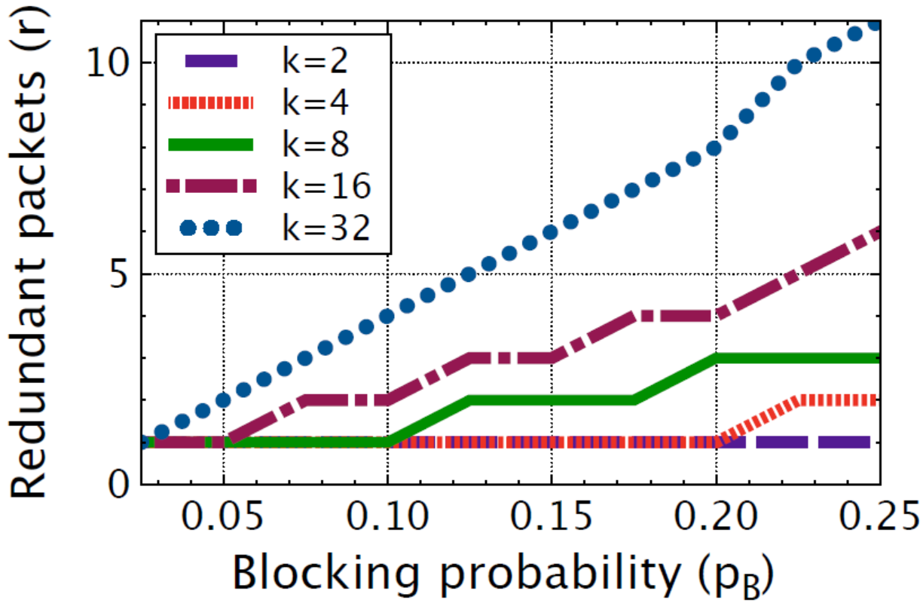
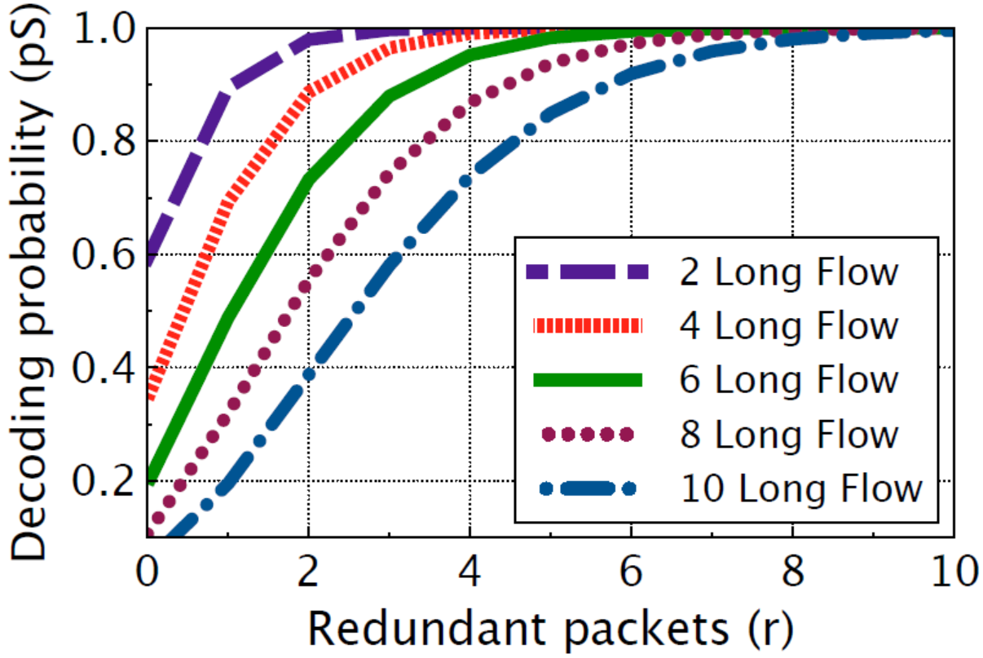
CAPS : redundancy optimization
(1)
18/4/19
12
12
Notes:
During the encoding procession, an important task is to dynamically adjust the number of redundant packets according to real-time network traffic.
equation (1), the least number of redundant packets r for each k source packets with the blocking probability pB.
left figure ,with the increase of pB and k, more redundant packets should be needed for decoding.
equation (2), the successful decoding probability pS is computed.
right figure, with the increasing number of redundant packets , the successful decoding probability becomes larger due to more unblocked packets.

Slide 15
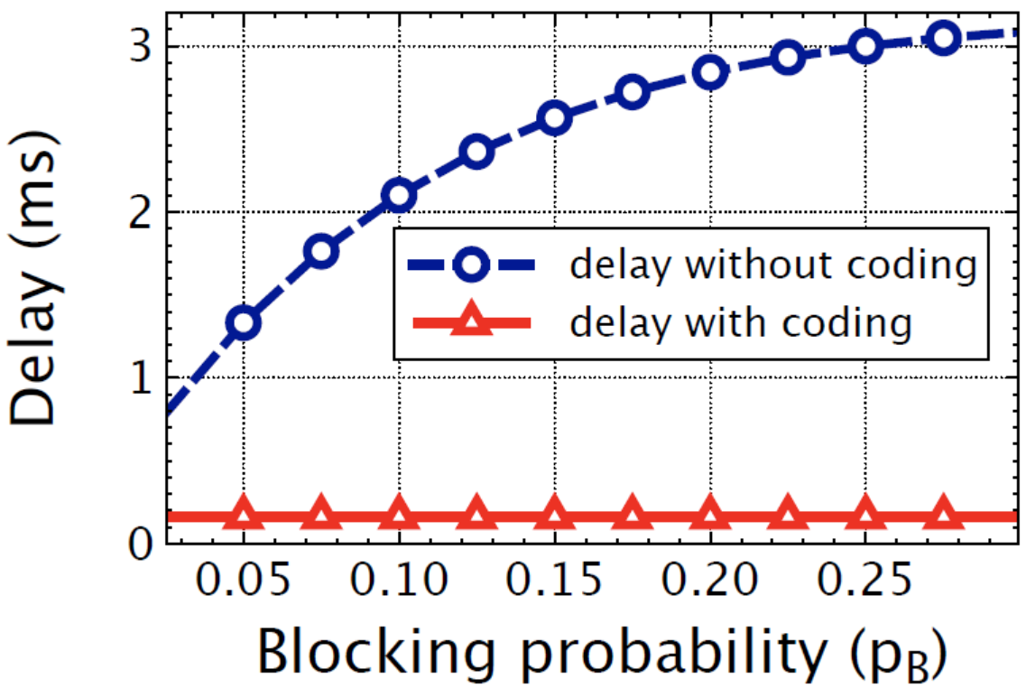
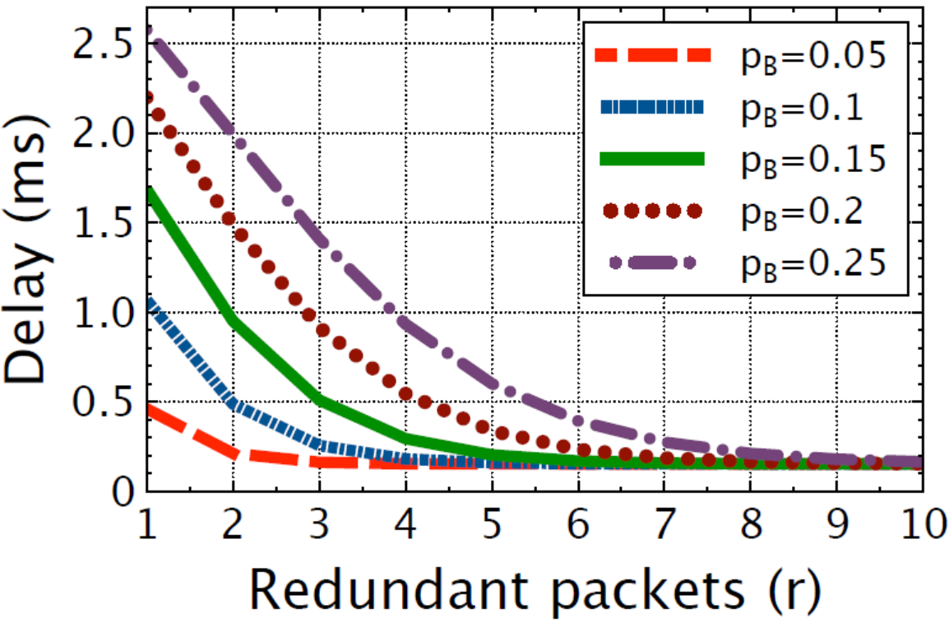
CAPS : delay performance analysis
(1)
(2)
18/4/19
12
12
Notes:
we also analysis the delay performance of CAPS.
In Equation 1, dnc is the average delay of k packets without coding
In Equation 2, dc is the average coding delay for a coding unit
Left figure clearly show dnc is much greater than dc, it means the total delay is significantly reduced by the coding operation.
Right figure shows the coding delay dc decreases as the redundant packets increasing under different blocking probability pB.

Slide 16
Outline
Background
Motivation
Impacts of Long Flows on Short Flows
CAPS Design
Evaluation
Summary

Slide 17
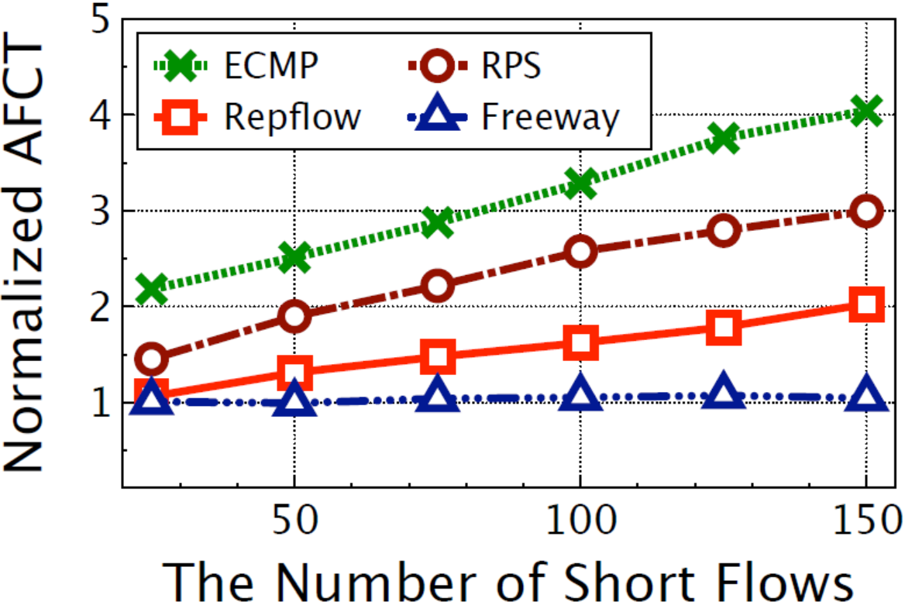
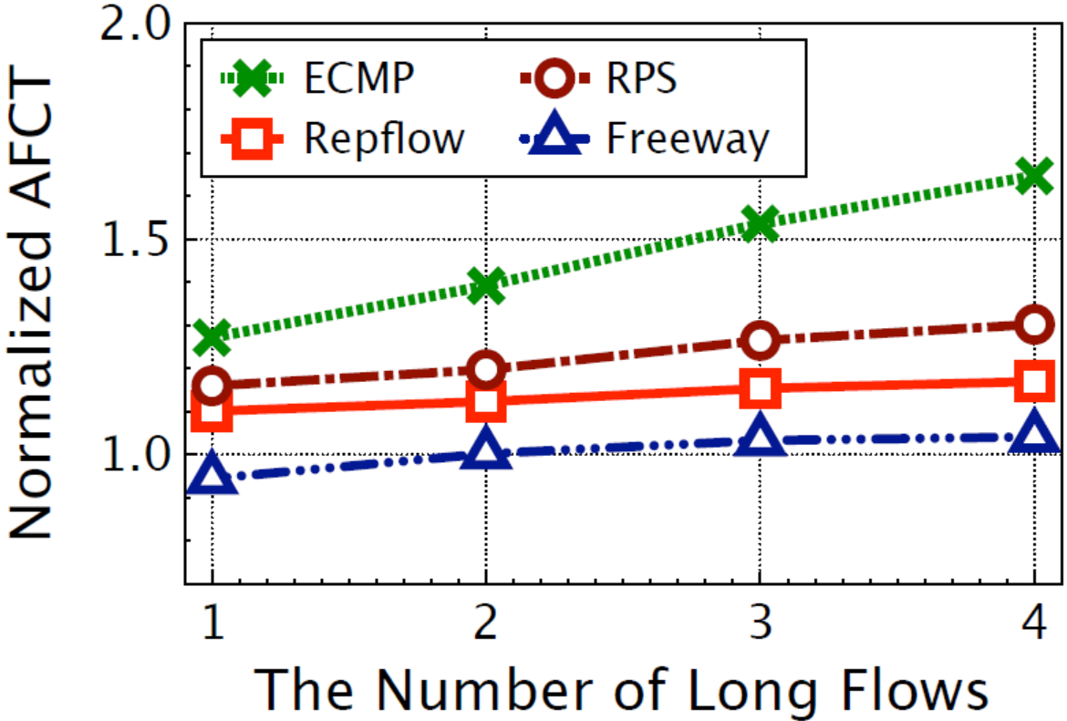
Testbed Results (Normalized AFCT)
Testbed settings
Mininet 2.3.0; 2-layer Leaf-spine topology
20Mbps bottleneck link; 56 hosts, 2 ToR switches, 20 core switches
Notes:
implement CAPS on Mininet based on Linux kernel.
Both figures show the AFCT is improved by CAPS with increasing the number of short flows and long flows respectively.
CAPS compared with four schemes.and achieves better performance.
Because ECMP and RPS are agnostic to the short and long flows, RepFlow only replicates, but doesn’t isolate short flows from long flows on different Paths.

Slide 18
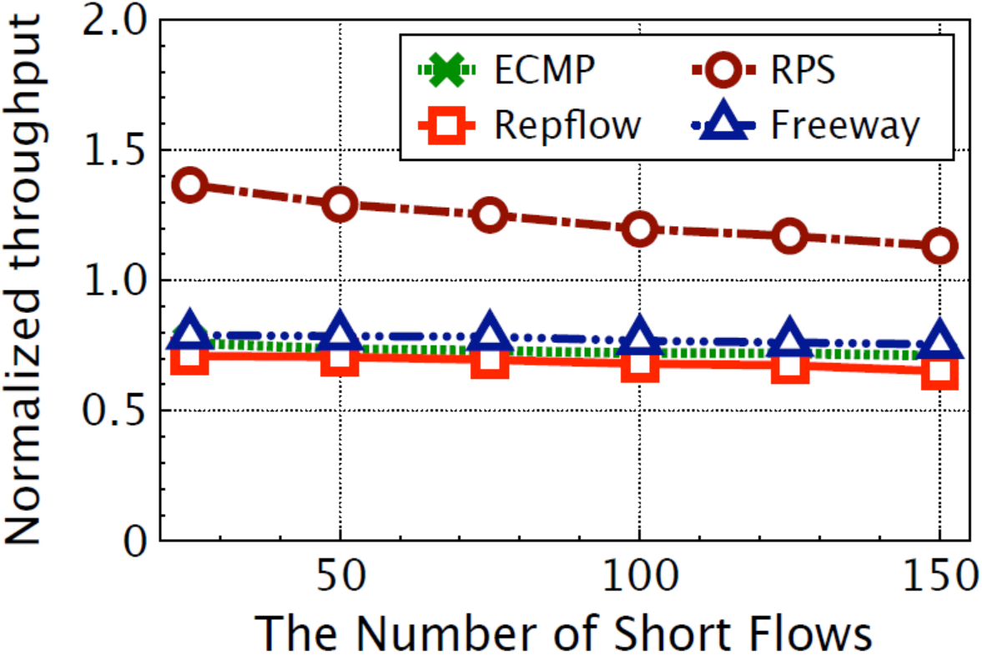
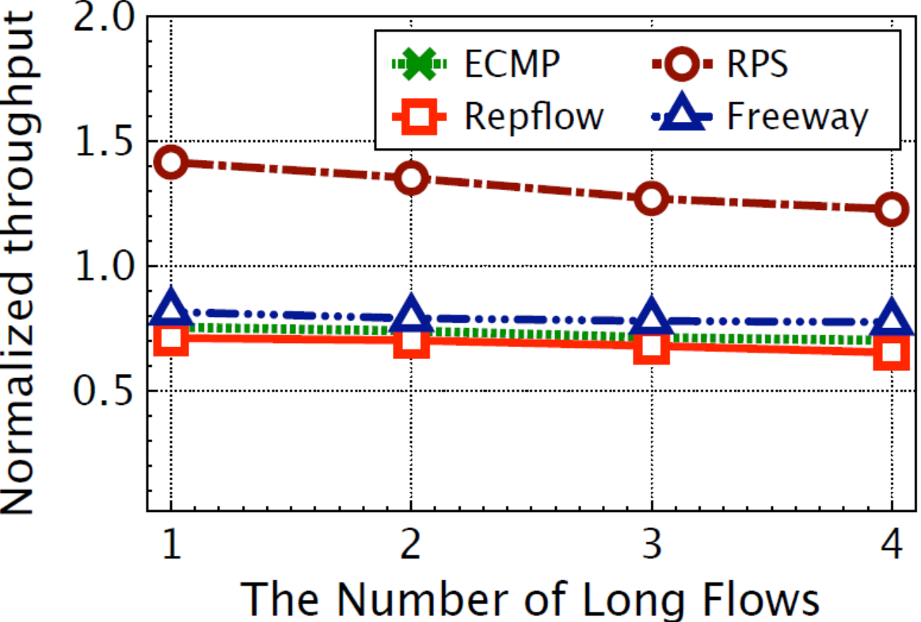
Testbed Results (Normalized Throughput)
Testbed settings
Mininet 2.3.0; 2-layer Leaf-spine topology
20Mbps bottleneck link; 56 hosts, 2 ToR switches, 20 core switches
Notes:
normalized throughputs of long flows with also increasing number of short and long flows respectively.
CAPS improves the throughputs of long flows by around 35% over flow level schemes. The reason is that ECMP, RepFlow and Freeway employ only one path to transfer each long flow, resulting the low utilization on the multiple paths.
CAPS and RPS work on the packet level and flexibly spread the packets to all paths, obtaining the higher throughputs of long flows.

Slide 19
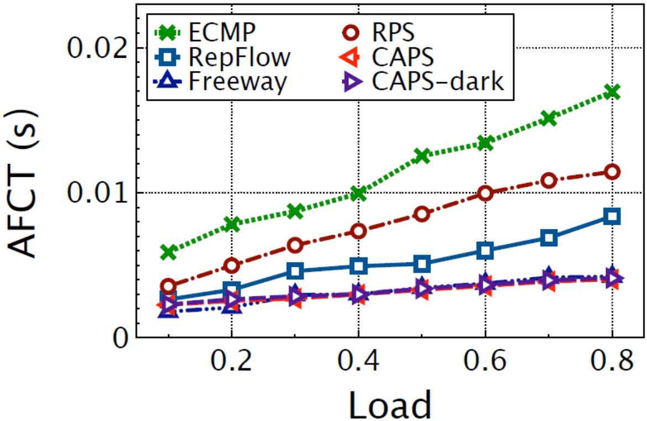
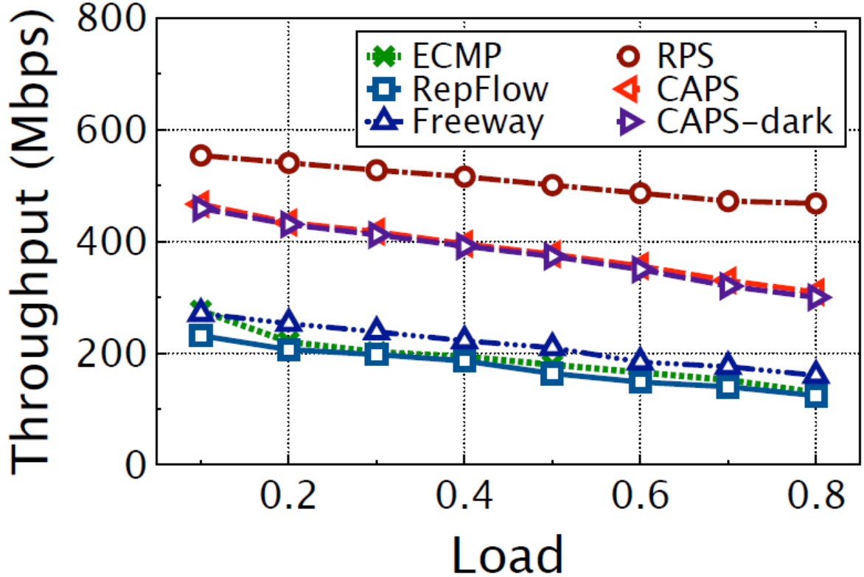
Larger-scale Simulations (web search)
Simulation settings
NS2 simulator; 2-layer Leaf-spine topology
1Gbps bottleneck link; 864 hosts, 24 ToR switches, 12 core switches
better
better
Reducing the AFCT
up to ~60%
Improving the throughput up to ~100%
18/4/19
16
Notes:
To complement our small-scale testbed experiments, we further conduct large-scale simulations using NS2 in the web search and data mining application scenarios.
These two figures are under the web search workload.
It reduces the AFCT of short flows by around 60% over RPS. And CAPS significantly improves the throughput of long flows compared to the flow-level schemes.

Slide 20
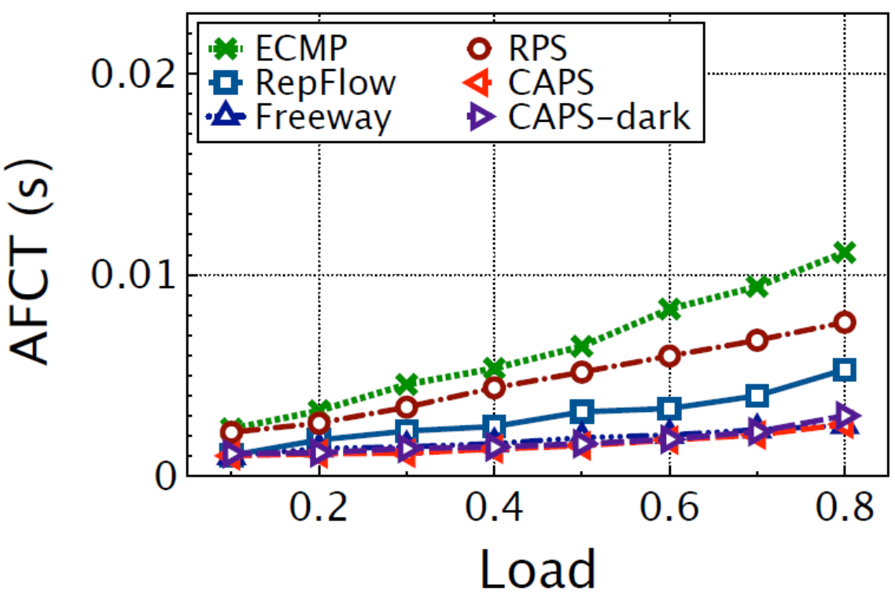
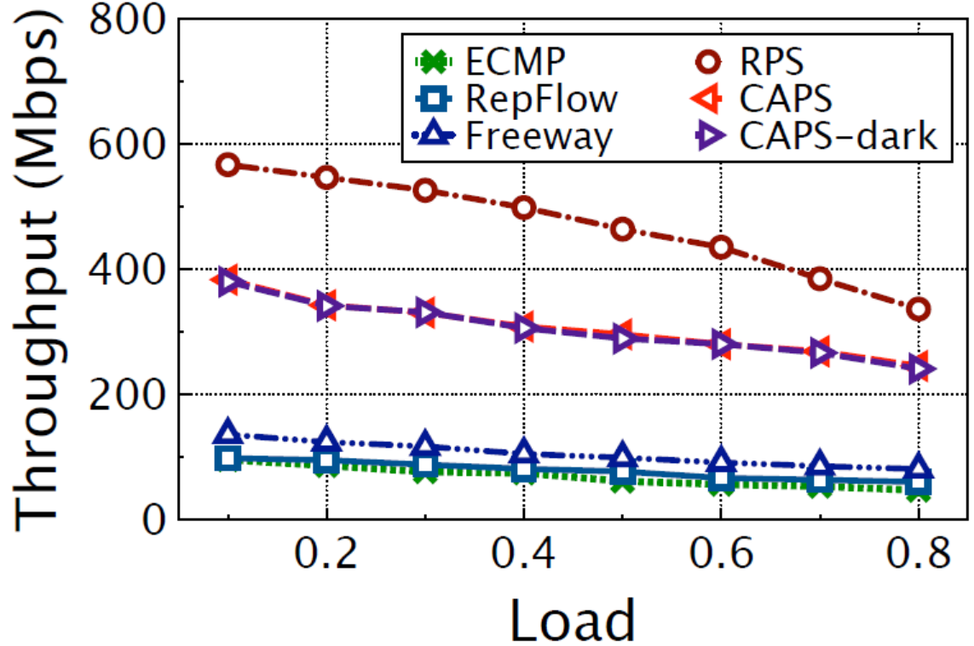
Larger-scale Simulations (data mining)
Simulation settings
NS2 simulator; 2-layer Leaf-spine topology
1Gbps bottleneck link; 864 hosts, 24 ToR switches, 12 core switches
better
better
Improving the throughput up to >100%
Reducing the AFCT
up to ~50%
18/4/19
16
Notes:
Similar to web search application, the performance of CAPS in data mining scenario is also improved..significantly.

Slide 21
Outline
Background
Motivation
Impacts of Long Flows on Short Flows
CAPS Design
Evaluation
Summary

Slide 22
Summary
Long flows hurt short flows
Head-of-line blocking
Out-of-order
Challenges for CAPS
How to mitigate the negative impact of short and long flows on each other to reduce the FCT for short flows and guarantee the throughput for long flows?
Key points of CAPS
Limit long flows to only a few paths by ECMP
Spread packets of short flows to all paths by RPS
FEC coding for short flows
Spread packets of long flows to all paths by RPS when short flows are in OFF mode
18/4/19
18
Notes:
two key issues with multipath transmission in RPS are explained. The first one is head-of-line blocking caused by the long flows, and the second one is the out-of-order problem.
Negating the impacts of short and long flows on each other is a very important issue.
CAPS limits long flows to only a few paths to avoid the head-of-line blocking and spreads long flows to all paths when short flows are in OFF mode to achieve high throughput.
CAPS uses the FEC technology to only encode short flows and spreads short flows to all paths.

Slide 23

Thank you !
Q&A
18/4/19
19

